Slide 1
AI-Assisted Churn Analysis — Quick Brief
Problem: rising subscription churn. Objective: identify drivers, segment risk, recommend actions with budget priorities.

Slide 2


Key Churn Drivers (AI-derived)
Service Quality
Billing Friction
High dropped calls, low data speeds → strong churn signal
Unexpected charges, late-payment patterns → churn spike
Support Volume
Plan Fit & Tenure
Repeated complaints in 30-day window → retention risk
Misaligned plan vs usage and short-tenure accounts → vulnerable
Method: feature importance from model (usage, billing anomalies, complaint count, contract type, tenure).

Slide 3

Risk-Based Segmentation
Data: model thresholds tuned for precision on High risk (reduce false alarms).
High Risk
Medium Risk
Low Risk
Top 12% by predicted probability. Recent complaints, billing issues, high service degradation.
Next 28%. Usage drop, intermittent support contacts, borderline billing delinquencies.
Remaining customers. Stable usage, on-time payments, few support interactions.

Slide 4

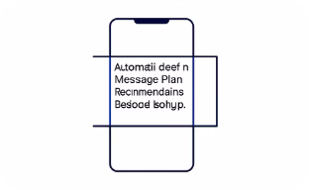
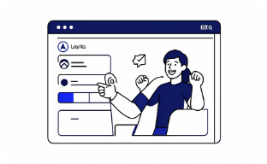
Retention Actions & Budget Allocation
High Risk — Personal Rescue
Medium Risk — Targeted Campaigns
Low Risk — Loyalty & Upsell
Immediate outreach + rollback fees + tailored offers. ETA: 0–7 days. Budget: 50% of retention spend.
Rewards, feature nudges, long-term incentives. Preserve revenue, small per-customer cost. Budget: 20%.
Personalized plan swaps, credits, proactive diagnostics. ETA: 7–30 days. Budget: 30%.
Next steps: deploy model to score weekly → trigger playbooks → track lift by cohort (churn %, retention cost per saved user).

